Slide 1
ActionBar
Lecture 5.2
Tom Karni, Itsik Avidan

Slide 2
Usage
User actions
Navigation modes
Consistent interface across applications
Menu

Slide 3
Backwards compatibility
Available as part of the OS form Android 3.0 (API level 11)
Older versions can use : ActionBarSherlock Action Bar compatibility package

Slide 4
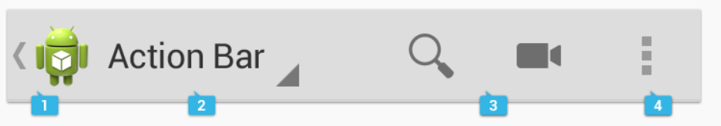
Main features
1. App icon/logo
2. View control (tabs, drop-down, non=interactive content)
3. Action buttons
4. Action over flow (less important actions)

Slide 5
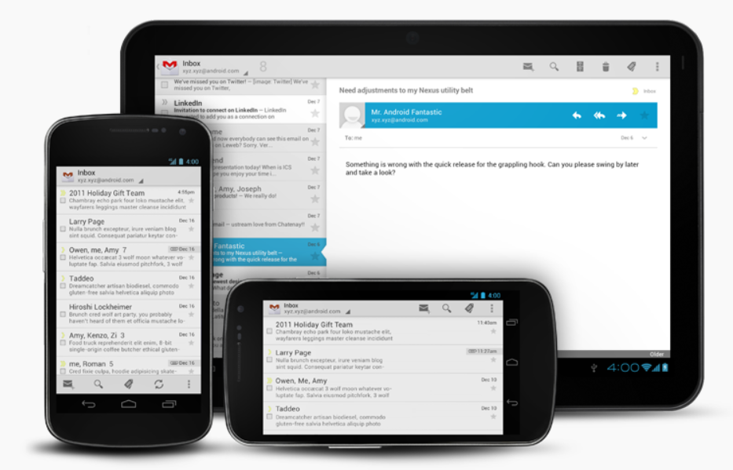
Rotation and Different Screen Sizes

Slide 6
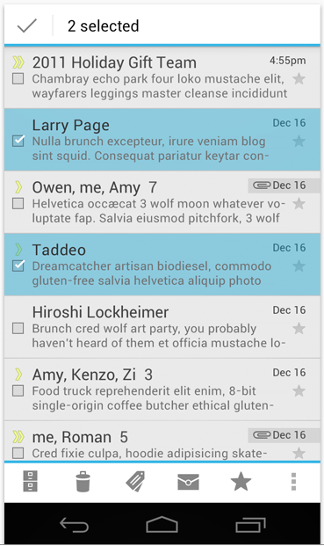
Contextual Action Bars (CAB)
Temporary action bar that overlays the app's action bar

Slide 7
View Controls
Tabs (fixed, scrollable)
Spinner (drop-down)
Drawers (slide-out menu to switch between views)
Action buttons

Slide 8
Add / remove
Theme.Holo
actionBar.show();
to remove: Theme.Holo.NoActionBar or ActionBar actionBar = getActionBar(); actionBar.hide();
!!! if you remove the action bar using a theme, then the window will not allow the action bar at all, so you cannot add it later—calling getActionBar() will return null.

Slide 9
Action Items
onCreateOptionsMenu() inflate from xml menu file or add new items here.
android:showAsAction
When clicking: onOptionsItemSelected() (activity’s brfore fragment’s)
Always define android:title for each menu item

Slide 10
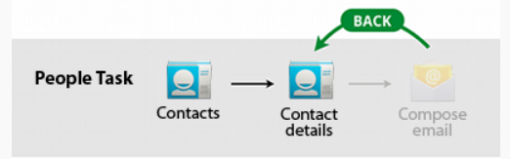
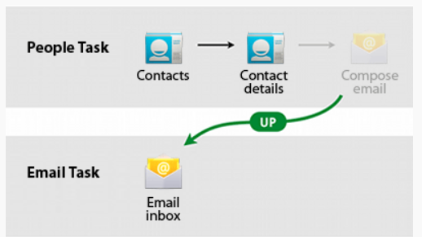
Navigating up

Slide 11
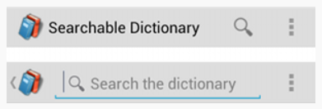
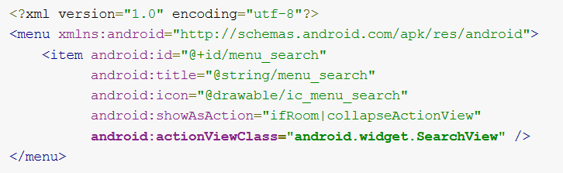
Action View
a widget that appears in the action bar as a substitute for an action item's button.
SearchView searchView = (SearchView) menu.findItem(R.id.menu_search).getActionView();

Slide 12
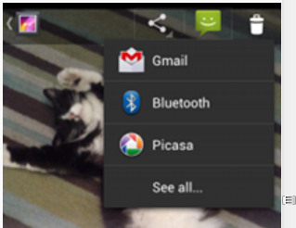
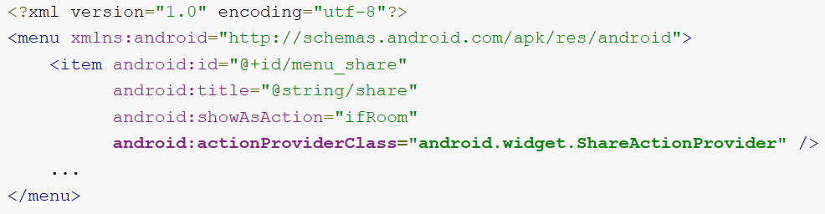
Action Provider
an action provider (defined by the ActionProvider class) replaces an action item with a customized layout
Create your own

